Slide 1
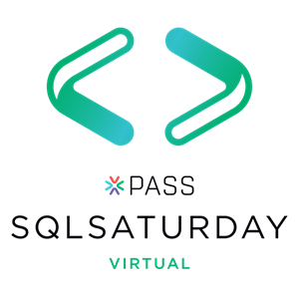





#1000 Oregon

Slide 2
Looking to expand your technical skills?
Check out Microsoft’s “Dashboard in a Day”, “App in a Day” and other brand new “in a Day” trainings
Hosted every week by Microsoft Partners around the world, including Marquam
Ask your preferred local Microsoft Partner or sign up at marquam.com/events or info@marquam.com

Slide 3
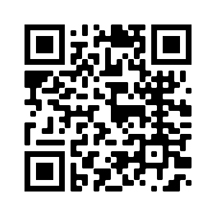
Want to provide feedback on the presentation?
https://www.surveymonkey.com/r/PSKT9VC

Slide 4


Certification Exams Inside Out
William Assaf Data Platform MVP
Notes:
I just want to start by saying I hope everyone is safe and healthy and is doing everything they can do to stay that way, including staying at home and taking all appropriate precautions, even if your local government isn’t insisting you do so.
If you’ve become unemployed recently because of the pandemic, please reach out to me on LinkedIn, my wife and I would be happy to share time and resources with you in your job search, she has a lot of experience in this area, and we’d be happy to spend some free time on resume review and interview coaching. We are happy to help.
A little about me at the beginning, I’m a former Principal Consultant and a Microsoft Data Platform MVP and more relevant, I have been a SME for item review and an item writer of SQL Server certification exam test questions since 2012, something that does not sound very exciting, but it is still quite informative and useful to me in my career.
I’m presenting here based on that experience for your benefit, and I hope this is the most interesting and possibly fun presentation on certification exams you’ve ever been a part of.

Slide 5
Pop Quiz
You are a member of the Council of Elrond.
You must choose someone present to bring the One Ring to Mordor. One does not simply walk into Mordor. The ring-bearer must not be desirous to use the ring to help their own kingdom. The ring-bearer must not own another of the Rings of Power.
You need to choose a ring-bearer.
Who should you choose?
A. Smeagol
B. Boromir of Gondor
C. Frodo Baggins
D. Gandalf the Grey
Notes:
Pop Quiz!
<read slide>
<click>

Slide 6
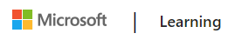
Summary
Who exams are for
New Role-based Microsoft certs and exams
How Exams are Written
Test-taking tips
Deconstructing the wrong answers
Sample exercises
Content is not specific to Microsoft technologies and exams, though that is where my experience lies as a consultant, as a certified pro, and as an exam item writer.

Slide 7
Certified Technology Professionals
Certified employees are 17% more productive.
Certified reduce unplanned downtime when problems arise by 56%
Certified employees are generally more satisfied with their jobs and enjoy tenures that are 15% longer than uncertified employees.
72% of employers require IT certifications for certain job openings
60% of employers use certifications to confirm subject matter expertise.
Microsoft Learning White Paper http://download.microsoft.com/download/9/4/B/94B5442E-0494-4B42-A5DC-8742E4254B09/BVW-Microsoft-US40548315.pdf
CompTIA HR Perception of IT Training and Certification Study: 2015 https://certification.comptia.org/docs/default-source/downloadablefiles/hr-perceptions-of-it-training-and-certification.pdf
Notes:
<read notes instead>
Here are some statistics from both Microsoft and CompTIA talking about employees who are certified being more productive, responding better, having better careers, being respected by employers. Does a certification make you a better database administrator per se? No, I’m not implying causation here, but the process of preparing for an exam, the preparation of the materials, and the mindset that led you to the self-improvement path of the certification exams, those are all productive, causative, and beneficial for your career. So good for you for attending this session today and probably feeling the need to get certified.
A final note I’d say is that becoming certified makes your skillset broader, more aware of features, and potentially better at choosing the right solutions for the right problems.

Slide 8
What Exams Try to Test
When deciding on exam content, SMEs are asked: “Is this a skillset that you do regularly?” or “Is this a skillset you would ask for when hiring?”
If a group of worldwide SMEs does not think a feature is important, it’s doesn’t go on the exam.
However, new features for new versions are likely to be included on the exam, to certify people working in the newest version(s).

Slide 9
Before and After the exam is live
SMEs used in all phases of exam development.
In Beta and when the exam is live, question success and feedback is analyzed by a psychometrician.
Exams can be refreshed for new/better content without changing the exam number.
New product capabilities/features often get a special focus on exams.
Notes:
<read notes>
Microsoft subcontracts out SMEs globally for various phases of question development. Topics are removed from the exam’s domain if none of the SMEs present could say they use it in real life. SME’s are asked questions about the value of different technical topics.
Then, how many questions on each subject area should be there in the domain?
Item Writers are given assignments to cover a narrow domain.
Item Writer team must make sure they’re not overlapping or creating nemeses that giveaway answers to other questions.
Then a review process and alpha exam process occur with yet another group of SMEs to fine tune the items.
<click, read slide then notes>
At Microsoft her name is Liberty Munson, she’s got a neat job.
She studies statistical correlation between question success and exam success.
Do candidates who pass get this question right? Good.
Do candidates who pass get this question wrong? Not good.
Is question success unrelated to this exam success? They’re guessing.
Your comments on the exam are reviewed, by name. Be professional.
Your comments can contribute to changing/abandoning a question. For example, "Why are you testing this? I'd look this up!“ That kind of comment gets attention.
<click to 2>
<read slide>
For example: SQL 2016 exams were later updated in 2017 for new content including Azure, exam number did not change. This is an example of new product features that are added to an exam without changing the exam number.

Slide 10
Guidance for Employers
Microsoft exams are designed to test experience, not book knowledge.
So asking a kid out of college or an entry-level employee to take a cert exam is not something I advise. It leads to one of three outcomes:
They pass the exam. (Least likely)
More likely:
They fail the exam, possibly multiple times, resulting in frustration/disillusionment, even career derailment.
They try to cheat. Outcomes dubious.

Slide 11
Certs and Your Employees
Exams target people with at least 2+yrs experience.
MCSE-track exams are for 5+yrs of experience.
Don’t have unrealistic expectations at entry-level, for yourself or your employees.
Put cash bounties on exams, but with no time limit.
Pay the exam fees. Even if they fail.
Incentivize taking exams for the right reasons.
Notes:
Reward success but not to excess. Career progress should also occur outside of exam.

Slide 12
How to Train an Employee
Classroom training lengthy, hit-and-miss.
Travel conferences are expensive, lengthy.
Instead: Self-paced learning, labs resources.
Notes:
<read slide>
If you’re in consulting, like I am, then classroom training is a double whammy, you’re losing the billable hours and the cost of the training.
<click, read slide>
(2020)That said, I highly recommend, for data platform folks, the all-virtual PASS Summit happening this November. It was supposed to happen in Houston, but unfortunately it was cancelled. It’s now quite inexpensive, but same high quality content. But anyway.
Tips on travel conferences:
1. Require knowledge transfer afterwards. It makes the notes the attendee takes a little more detail oriented.
And another Tip: Require proof of hands-on-lab completion when sending employees off, or specific technology goals. Lots of big conferences
<click, read slide>
Those resources should probably include Azure credits for self-paced lab learning.
Employees should also take advantage of the easy free training opportunities to earn expensive paid ones (Hint: This. Event. Right. Now.) So give yourself a pat on the back.

Slide 13
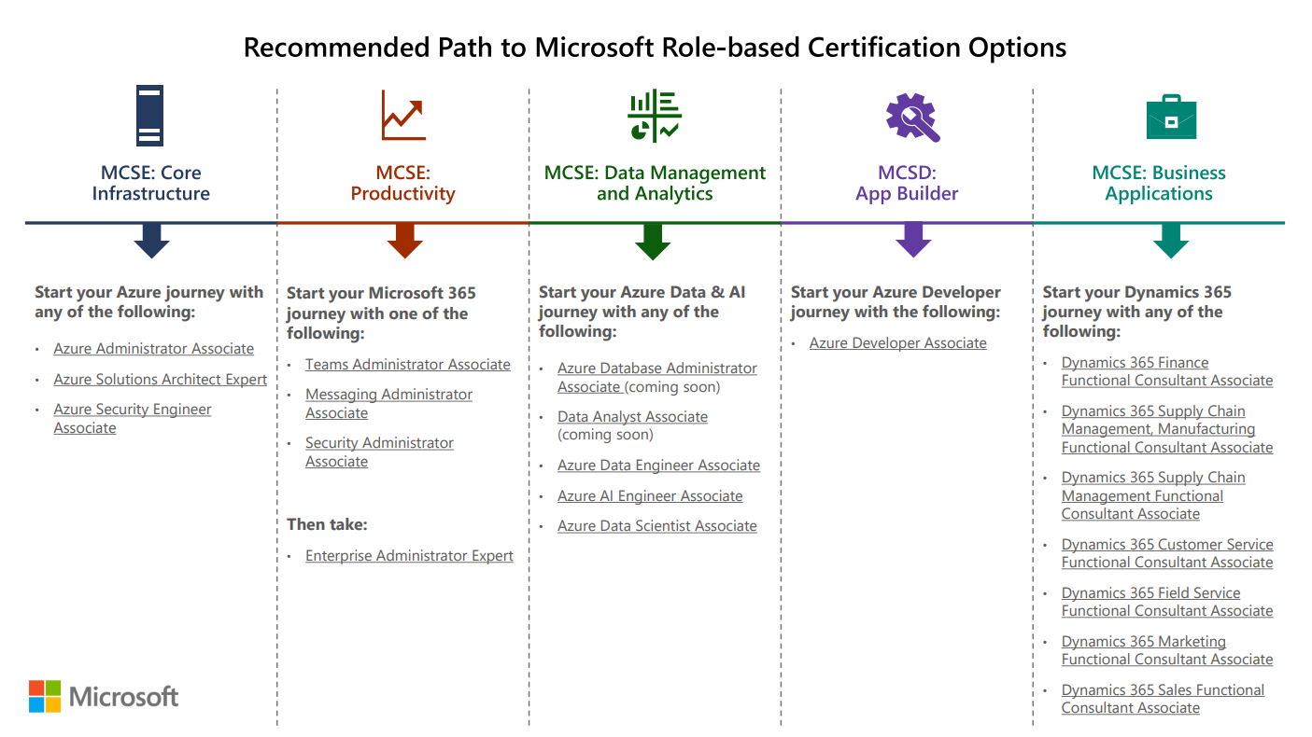
Role-based certs have replaced older certs
Notes:
So, first, What have they done with my MCSD/MCSE/MCSA?
If it starts with 70-, the exam is almost certainly already retired or will be retired by January 2021. That deadline was actually moved back six months because of COVID-19! This includes all exams associated with MCSA MCSD and MCSE, tho, the certifications themselves will remain on your official Microsoft transcript until no later than June 2022. Over the past few years, exams starting with letters like AZ, DP, AI, for example, are the newer exams you’re looking for.
Those older exams we’ve h all along were technology or platform based. Now, Microsoft exams are role based.
There will not be Windows Server 2019 and SQL Server 2019 certifications for those products, instead, there will be exams focusing on roles, like Solutions Architect, Enterprise Administrator, Azure Data Engineer, Azure Developer, Functional Consultant, etc. These roles are expected to have broad experience with all their relevant features and products.
Microsoft’s Emphasis is on Solutions has evolved over the last decade, and now we have these role-based certs and exams.
There is no such thing as a one-dimensional certification because there are few cases of one-dimensional jobs.
This is intentional and raises the value of a certification – a certification should mean you have broad experience.
Focus on practicality and actual usage.
This isn’t new, in the last generation of SQL exams, before the big push for Azure content, to get the SQL Server MCSA, you need to know how to build end-to-end Business Intelligence, SSIS, SSRS, SSAS, in addition to the expected administration and querying.

Slide 14
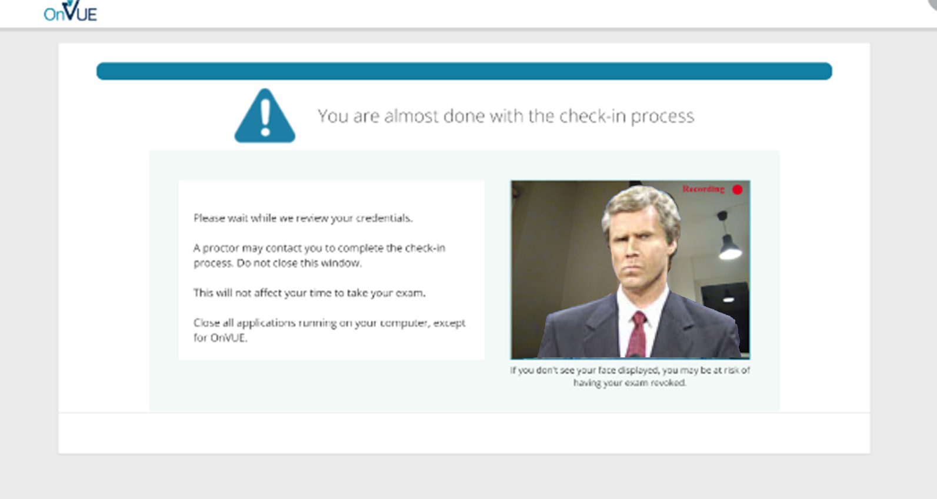
But Right Now? How?
Online Proctored Exams.
Notes:
So, last question. You’re wondering, with a pandemic, and hurricanes, and between all my hiding under the safety of the covers, how do I take a Microsoft Certification Exam? What testing center in Baton Rouge is even open this week?
Thankfully Pearson VUE and Microsoft had already offered online proctored exams, and now they are expanding this offering’s availability because many testing centers have closed. It’s a live proctored exam, which means you’re taking the exam at your home or office, with someone actively watching you via a webcam and listening to you via your computer. In fact this whole process is easiest if you are taking the exam with a laptop with a built-in webcam.
They for the most part work fine technically, though they are unforgiving. I have taken three online exams since the pandemic started.
Each time I took an exam, new security requirements were added that became stricter, as they looking for more things.
You have to take pictures of your testing area, from all angles, including the floor and ceiling, your ears and glasses, etc. You have to cover any screens around you, erase any whiteboards, close any window blinds. This remote inspection process may take up to half an hour, so make sure to log into your exam early to give yourself plenty of time to go through their security process, and use the same browser, I recommend using Chrome, throughout.
There are stories out there of people walking through the room behind you, or hearing distant voices, and boom, the remote test monitor fails your exam with no refund. You are warned ahead of time, pretty clearly.
So make sure you’re taking your online proctored exam in a place where no one else can be seen or heard, including your kids. I put a sock on my home office door and told my wife and my college kid who is stuck at home, to not make any noise or enter the room for a couple hours. That’s what’s necessary.
Honestly, it’s worked pretty well for me so far, though my boss had issues with a browser and lost his exam slot and had to fight for a refund. Even after the pandemic passes, I might still consider the online proctoring just because it saves hassle and travel. It works well.

Slide 15
Beta Exams
You can take new cert exams for new technology for significant discounts (not free any more, more like $20).
Follow the Microsoft Learn Blog for Beta announcements.
Notes:
For example, 300 registration codes were made available for AZ-303 and AZ-304, first come first serve.
With Beta Exams, you don’t find out whether or not you’ve passed right away. They evaluate the outcomes of the beta process and the questions. For example, I took the DP-300 and DP-900 beta exams, and it’s been nearly two months and I still don’t know whether I passed.

Slide 16
$15USD Exam Offer
Through 2020 anyone unemployed or furloughed due to COVID-19 can schedule one Microsoft Cert Exam for $15.
Offer here: https://docs.microsoft.com/en-us/learn/certifications/skillingoffer

Slide 17
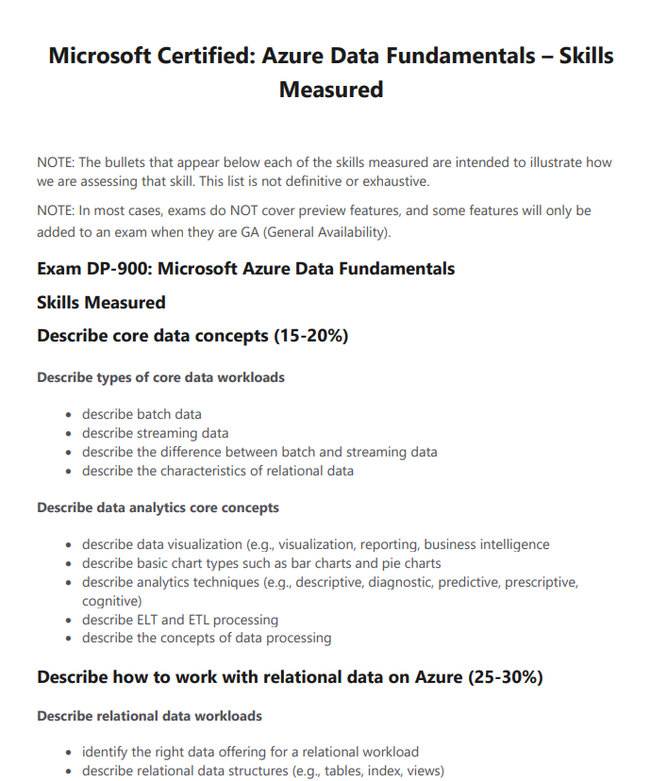
What Is On a Cert Exam?
https://docs.microsoft.com/en-us/learn/certifications/azure-data-fundamentals
Notes:
Straight from Microsoft.com, this provided is the “Skills Measured” section of an exam’s website, this is the “domain”.
The “domain” is determined by a group of SMEs before item writing begins, validated by real-life experience.
The “domain” tells the item writer what write about and tells you what to prep for.

Slide 18
How To Prepare for Cert Exams
Study by doing.
Review the domain. Unfamiliar features? Questions? “Lab it out!”
Microsoft’s training content on Azure topics is good, with in-browser free sandboxes.

Slide 19
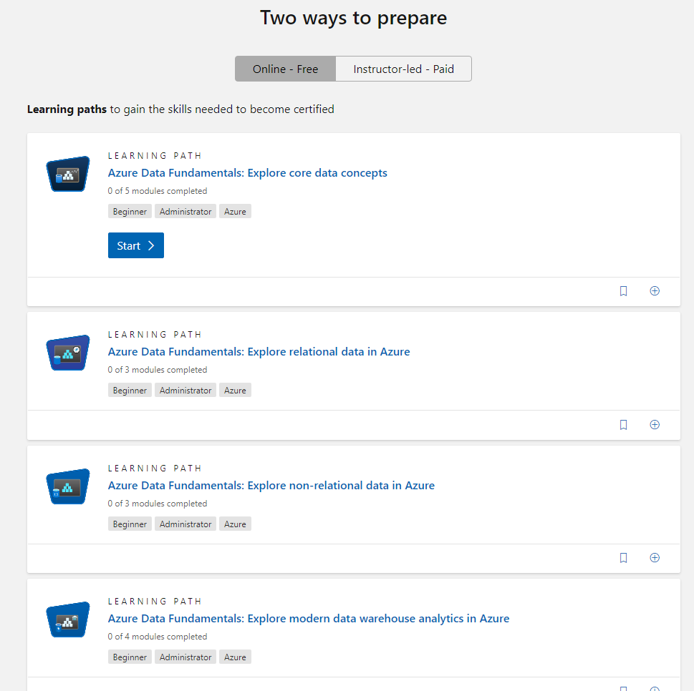
How To Prepare for Cert Exams
https://docs.microsoft.com/en-us/learn/certifications/azure-data-fundamentals
Notes:
This is just an example for AZ-900, the Azure Fundamentals exam, but there are hours of free interactive training with review quizzes on the website. These free materials aren’t available for all exams yet, but Microsoft’s use of the free built-in browser sandboxes is expanding.

Slide 20
How To Prepare for Cert Exams
Study by doing.
Lab environment at home or work, so you can build, break/fix, and learn.
Don’t have a test lab? Build one, it’s educational.
Invest significant time in your career.
Have a lab environment installed on your work/home PCs, or use Azure. (Free credits for students, new accounts, MSDN, etc.)

Slide 21
How To Prepare for Cert Exams
Do not study only by reading books/online.
Memorization is rarely tested.
Though, you must know the subject material,
proper feature choice is likely to be tested.
For example, code sample questions are likely to test dependency or correct tactic, not syntax.

Slide 22
What Exams Try to Test
The exam questions are highly situational.
You are doing something with these conditions and variables. What should you choose. a. X b. Y c. Z d. Q
Notes:
<read notes>
The exam questions are highly situational. So instead of asking "What is the difference between x and y?"
The question will be:
<click>
But, it’s not just multiple choice questions. Other types such as case studies, build lists, drag and drops, all operate on the same rules and challenge for the writers. But in the end, the challenge remains to create a right path, then, a bunch of incorrect distractors. We’ll talk more about that later.

Slide 23
Real Answer Options
The correct answer must be 100% correct. The "distractors" must be plausible, but 100% wrong.
But we can't make stuff up. Every answer you see is something real. We write plausible real wrong answers.
For example:
In SQL Server, there is no “CHECKSUM Recovery Model” you won’t see it as a choice on an exam.

Slide 24
Fun With Grammar
What "should you use" not "could use" or "would use“
"You need to" not "you must“
"By using" not "using“
"Named" not "called“
"You are developing" not "you are working on“
"by using the least amount of administrative effort" not "most efficiently" or "best” or “of course you’d do it this way”
"server that runs SQL Server" not "running SQL“ or “SQL server”
Also, if the word/phrase doesn't translate well, don't use it.

Slide 25
Fun With Grammar
The word "only" is a pain. It must be exact. Think translation!
Tonight we are serving enchiladas only.
Tonight we only are serving enchiladas.
Tonight only we are only serving enchiladas.
The "application only connects to one database”
vs.
the "application connects to only one database”
Notes:
Tonight we are serving enchiladas only. – that’s it for the menu
Tonight we only are serving enchiladas. – nobody else makes em
Tonight only we are only serving enchiladas. – tomorrow? Nope.
The "application only connects to one database” – doesn’t do anything else but connect
vs.
the "application connects to only one database” – connects to only one database (more likely the intention)

Slide 26
“Best Practices”
Never assume a question is asking you for the “Best Practice.”
Something in the question will make the other answers wrong.
“Best Practices” are not testable but may be used as distractors.
We can’t test:
unenforced naming conventions or file extensions
generally accepted standard
the normal order for this
how it has always been done
“industry knowledge”

Slide 27
Writing Distractors
If two answers seem correct, there IS a differentiator somewhere in the question.
Read the question carefully, note details.
At some point, the question writer introduced a factor in the question to make sure there is only one right answer and all other options are 100% wrong.
Writing wrong answers is more difficult than correct!
Notes:
<click thru slide>
Now, writing the right answer is easy, and its opposite is easy (though sometimes too obvious).
Creating challenging wrong answers sometimes involves introducing new variables or twists to your question, and it is difficult to keep the question scenario simple while being complex enough to have 3 legitimate wrong answers. Let’s talk about domain drift, it’s a real problem for item writers with complex questions.

Slide 28
Item Writer - Question Drifting
“Domain Drift” is when your question became so complicated, you end up with a question on a different topic.
Notes:
<read slide first>
Now you have to beg another Item Writer on the team to trade question assignments with you.
For example, if you were supposed to ask a question about peanut butter sandwiches, and ended up asking a question about which whether utensils can spread creamy peanut butter… Stay with me

Slide 29
Question Structure
A question will include:
a Technical Scenario,
a Problem Statement and Requirements,
a Goal Statement,
and a Question Statement.
For example:
You are making a sandwich.
You must make the sandwich with peanut butter.
You need to choose a utensil.
Which do you choose?

Slide 30
Writing the Wrong Answers Is Most Difficult
So your easy multiple-choice answers become:
Fork.
Spoon.
Knife.
Spork.
And everyone knows a knife is correct, right?
For example:
You are making a sandwich.
You must make the sandwich with peanut butter.
You need to choose a utensil.
Which do you choose?

Slide 31
Writing the Wrong Answers Is Most Difficult
But you can probably spread peanut butter with any of those, if you try hard enough. You cannot test “Best Practices” or “Industry Standards” for peanut butter distribution. So you change your Goal Statement.
For example:
You are making a sandwich.
You must make the sandwich with peanut butter.
You need to choose a utensil that will spread the peanut butter by using the least amount of administrative effort.
Which do you choose?

Slide 32
Writing the Wrong Answers Is Most Difficult
But says who?
Spoons and Sporks have virtually the same peanut butter delivery factors,
and it could be argued by some cultures that forks are the superior peanut butter-handling implements.
For example:
You are making a sandwich.
You must make the sandwich with peanut butter.
You need to choose a utensil that will spread the peanut butter by using the least amount of administrative effort.
Which do you choose?

Slide 33
Writing the Wrong Answers Is Most Difficult
So you complicate your question to test the exam-takers peanut butter solutions delivery experience…
For example:
You are making a sandwich.
You must make the sandwich with peanut butter and cut the sandwich in half using the same utensil.
You need to choose a utensil that will spread the peanut butter by using the least amount of administrative effort.
Which do you choose?

Slide 34
Writing the Wrong Answers Is Most Difficult
Now spoons are definitely out. You can’t cut bread with a spoon, it’s science.
But sporks and forks? Those could still get the job done, as well as a knife.
But spork and fork are not 100% wrong (yet)!
So you change your question again…
For example:
You are making a sandwich.
You must make the sandwich with peanut butter and cut the sandwich in half using the same utensil.
You need to choose a utensil that will spread the peanut butter by using the least amount of administrative effort.
Which do you choose?

Slide 35
Writing the Wrong Answers Is Most Difficult
Now spoons are definitely out. You can’t cut bread with a spoon, it’s science.
But sporks and forks? Those could still get the job done, as well as a knife.
But spork and fork are not 100% wrong (yet)!
So you change your question again…
For example:
You are making a sandwich.
You must make the sandwich with peanut butter and cut the sandwich in half using the same utensil. You do not have access to a hybrid utensil environment.
You need to choose a utensil that will spread the peanut butter by using the least amount of administrative effort.
Which do you choose?

Slide 36
Writing the Wrong Answers Is Most Difficult
Boom, now Sporks are CLEARLY not allowed (for no good real-life reason, only one made up for this question). An answer is made 100% wrong.
But forks remain a problem…
For example:
You are making a sandwich.
You must make the sandwich with peanut butter and cut the sandwich in half using the same utensil. You do not have access to a hybrid utensil environment.
You need to choose a utensil that will spread the peanut butter by using the least amount of administrative effort.
Which do you choose?

Slide 37
Writing the Wrong Answers Is Most Difficult
There’s no way you could spread creamy peanut butter with a fork, right?
Ta Da!
Sigh.
And that’s why cert exam questions take FOREVER to read.
For example:
You are making a sandwich.
You must make the sandwich with creamy peanut butter and cut the sandwich in half using the same utensil. You do not have access to a hybrid utensil environment.
You need to choose a utensil that will spread the peanut butter by using the least amount of administrative effort.
Which do you choose?

Slide 38
Writing the Wrong Answers Is Most Difficult
Notice all the little details that may seem extraneous at first.
This isn’t a question about sandwiches. This isn’t really even a question about peanut butter.
It’s a question about the details of solution selection.
For example:
You are making a sandwich.
You must make the sandwich with creamy peanut butter and cut the sandwich in half using the same utensil. You do not have access to a hybrid utensil environment.
You need to choose a utensil that will spread the peanut butter by using the least amount of administrative effort.
Which do you choose?

Slide 39
Item Writer - Question Drifting
What did we start writing a question about?
Utensils.
What did we end up writing a question about?
Bread geometry, peanut butter viscosity.
Notes:
And now you understand why it’s challenging to write exam questions about simple concepts, and why exam questions sometimes feel weighed down by different variables and factors. It’s why creating huge case study type questions, with several pages of information as the source of several questions, actually works out pretty well.

Slide 40
Give it a Try
Questions?
Then, Let’s give it a shot!
Notes:
<Notes first>
Before we go into some sample questions together, are there any questions?
<click>

Slide 41

Remember this?
You are a member of the Council of Elrond.
You must choose someone present to bring the One Ring to Mordor. One does not simple walk into Mordor. The ring-bearer must not be desirous to use the ring to help their own kingdom. The ring-bearer must not own another of the Rings of Power.
You need to choose a ring-bearer.
Who should you choose?
A. Smeagol
B. Boromir of Gondor
C. Frodo Baggins
D. Gandalf the Grey
Notes:
<click>
Gandalf already owns Narya, the Ring of Fire, one of the three Rings of Power made for the Elves.
<click>
Boromir is pretty much planning all along to get the ring back to Gondor.
<click>
Smealol is tricky because of course you’d rule out Smeagol, he’s been left twisted and consumed by the evil of the One Ring, but again, test questions will not use industry knowledge or assumptions or best practices, the wrong answers have to be 100% incorrect. In this case, <click>Smeagol was not present at the Council of Elrond, making this answer 100% incorrect, leaving nothing to doubt.

Slide 42
Question 2
You are the athletic director of a university.
The dean has instructed you to grow the athletic program. You must choose a new varsity sport that uses spherical balls. The sport must be able to sell tickets in the university’s outdoor grass turf venue to anyone.
You need to choose a new sport program.
What sport should you choose?
A. Basketball
B. Baseball
C. American Football
D. Quidditch

Slide 43
Question 3
You are the reel operator of a local cinema.
You must prepare a private showing of a film for a corporate event. The film must be a science fiction film featuring both alien(s) and android(s). You must not choose a film that features any raccoon(s).
You need to choose a film for the screening.
Which film should you screen?
A. Guardians of the Galaxy Vol 2
B. Blade Runner
C. Interstellar
D. Aliens

Slide 44
Question 4
You are the bartender of a local fine dining establishment.
You are instructed to serve an appropriate spirit to a diner. Your establishment only serves whiskeys aged in American oak barrels.The diner has requested a malt whiskey from outside of Tennessee. The malt must not contain corn.
You need to choose a spirit.
Which spirit should you serve?
A. Scotch Whisky
B. Bourbon
C. Tennessee Whiskey
D. Cognac

Slide 45
Question 5
You are the social media director for a cool hip company.
Your new marketing campaign much choose a social media platform. The platform must be persistent online forever. The grandmother and crazy uncle of the CEO must not be aware of the platform. The platform must currently ban political ads.
You need to choose a social media platform.
Which platform should you choose?
A. Facebook
B. Twitter
C. Instagram
D. Snapchat
Notes:
Twitter banned all political ads in October 2019, though Facebook and Facebook-owned Instagram have suggested they will only ban ads during the week before the election.

Slide 46
Question 6
You are an astronaut looking to land on a planet in this solar system.
Your new space base requires a solid surface. Your space base is equipped with a moon roof.
You need to choose a location for your new space base.
Which planet should you choose?
A. Jupiter
B. Venus
C. Pluto
D. Mars

Slide 47
Question 7
You are an admiral in Starfleet.
Your new flagship needs a captain. You may choose any out of the ranks of captains throughout time. The captain must have never willingly cooperated with the Borg. Because of the long voyage, the captain must have no children to leave behind. The new captain must have a superior hairstyle.
You need to choose a leader for your starship.
Who captain should you choose?
A. James T Kirk
B. Jean-Luc Picard
C. Benjamin Sisko
D. Kathryn Janeway

Slide 48
Helpful Links
http://www.sqltact.com/2012/04/certification-exams-from-other-side.html
http://www.sqltact.com/2016/07/training-to-do-list-for-new-dba.html
https://borntolearn.mslearn.net/b/weblog/archive/2014/03/10/certification-update-sql-server-2014
https://mva.microsoft.com/
https://www.microsoft.com/learning/en-us/exam-70-463.aspx
https://www.microsoft.com/en-ca/learning/sql-certification.aspx
https://www.microsoft.com/en-us/learning/exam-98-364.aspx
https://www.microsoft.com/en-us/learning/browse-all-certifications.aspx
Microsoft Learn Blog: https://techcommunity.microsoft.com/t5/microsoft-learn-blog/

Slide 49
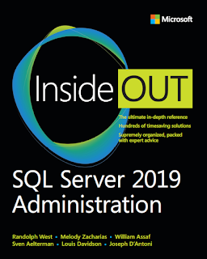
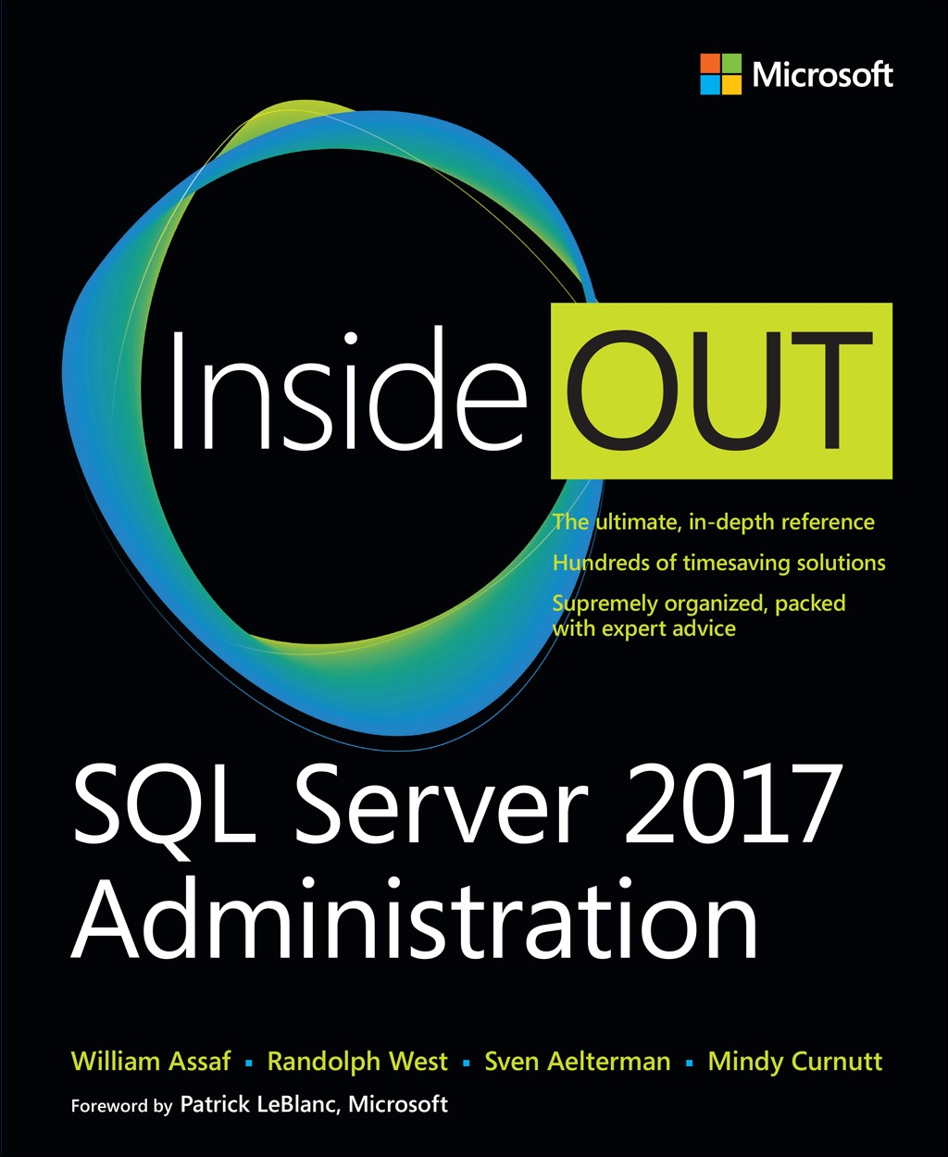
SQL Server 2017 Inside Out
SQL Server 2019 Administration Inside Out
by Microsoft Press
2017 published Feb 2018
2019 published March 2020

Slide 50

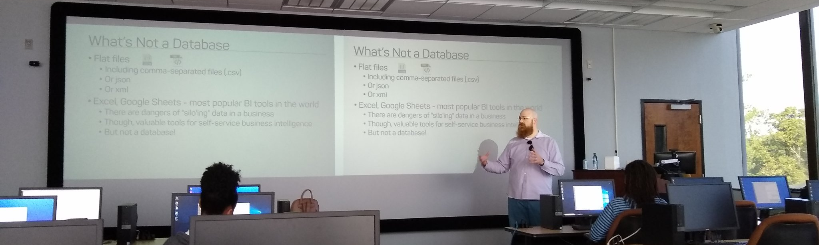
Support your Local STEM Initiatives
I encourage you to find, then donate time and money to local STEM education initiatives where you live. Get involved!
There is almost certainly some nonprofit where you live that needs your enthusiasm and skills to close the achievement gap.
https://www.thewallsproject.org/programs/futures_fund/
Notes:
Here’s a STEM education nonprofit local to me that I volunteer for, please reach out and share your knowledge with the next generation, and especially with folks in your community that are needing to find new careers during the pandemic.

Slide 51


William Assaf
Principal Consultant, Microsoft MVP Data Platform
Senior Content Developer, Microsoft
SQLTact.com
Co-author, Microsoft Press SQL Server Administration Inside Out 2017 and 2019. MS Cert exam writer since 2012.
linkedin.com/in/williamdassaf
@william_a_dba
Notes:
This presentation is available for download at my blog SQLTact.com.

